Slide 1
Illegal Immigration
By Karen Moreno

Slide 2
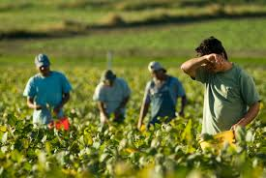
Thesis: Role of illegal immigrants in our society:
Illegal immigrations can and does help the economy through paying taxes, Helping the Social Security administration, the agriculture sector, and keep many aspects of the economy thriving.

Slide 3
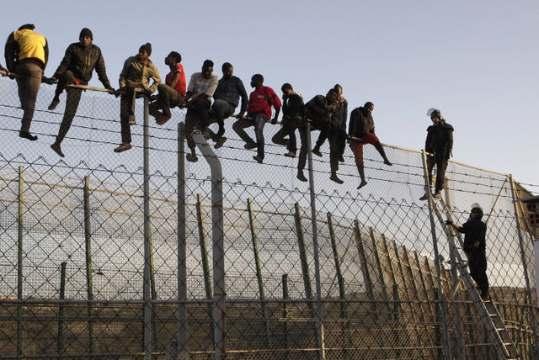
What is illegal immigration?
When a foreigners enters the country without any legal documentation.

Slide 4
Do Immigrants pay their fair share in taxes?

Slide 5
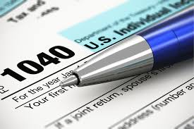
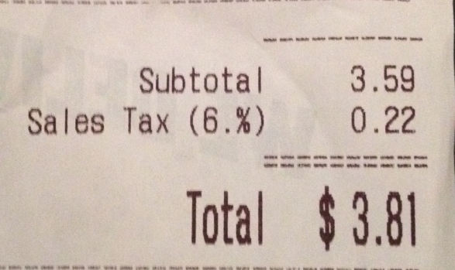
Immigrants contribute by Paying taxes
Illegal immigrants pay
Income taxes
At least 50% of immigrants pay income taxes through ITIN.
They pay about 1.1 billion in income taxes.
Sales taxes
Immigrants pay 6.9 billion in sales tax
Property taxes
They pay 3.6 billion in property taxes (Soergel, 2015)

Slide 6
More Economic Contributions Social Security System

Slide 7
Pro: Social Security system
With a population of 11 million people, Illegal aliens contribute millions to the social security system.
They $15 billion a year to Social Security through the payment of income taxes
Over the years, undocumented workers have contributed up to $300 billion, or nearly 10 percent, of the $2.7 trillion Social Security Trust Fund.
Immigrants contribute more to social security than they will ever receive.

Slide 8
Why would this matter and who would it matter to?
The Baby Boomers depend on the contribution of illegal immigrants to the Social Security Reserve
The increase of life span will add some serious numbers to the amount of people that will depend on social security.

Slide 9
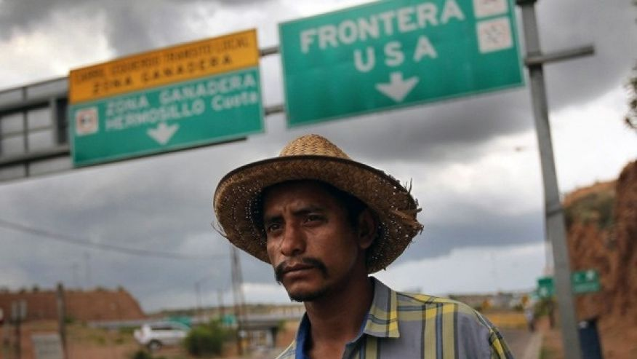
Illegal Aliens can help baby boomers in two ways
Serving elders in their homes
According to a recent study by AARP, 90% of Baby Boomers desire to age in their homes.
¼ of today’s care takers were born outside the United States.
At the least 1.8 million care takers will be needed in the near future
Contributing to the Social Security Department
As stated before they $15 billion a year to Social Security through the payment of income taxes
Over the years, undocumented workers have contributed up to $300 billion, or nearly 10 percent, of the $2.7 trillion Social Security Trust Fund.
If illegal immigrants were to be legalized they would add up an amazing amount $500 billion over a period of 36 years, coinciding with the exact time aging baby boomers are expected to put the most strain on the system. (POO, 2015)

Slide 10
How do Immigrants impact the economy of Agriculture?

Slide 11
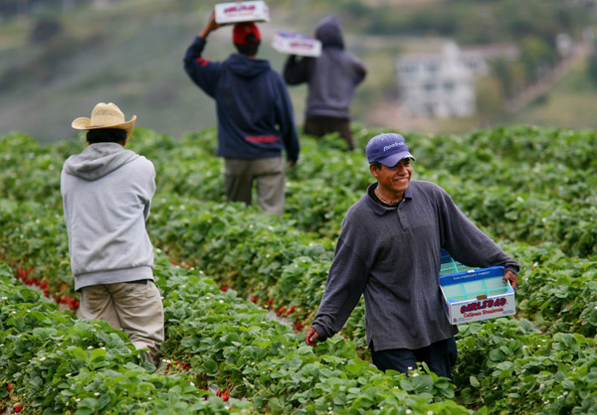
Labor in Ag.
Labor economist say illegal immigration provides a great labor supplies.
Economist have predicted that without this source of labor, the economic growth of the country would decline by 250 billion.

Slide 12
Costs:
Due to the cheap labor illegal immigrant provide. Goods have lower costs because not a lot of money is spent paying field workers.
The reason for this is because illegal immigrants get paid 20% less than legal workers.
Result:
Lower prices for consumers
Higher profits for employers

Slide 13
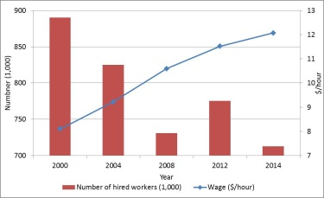
Evidence that supports the need for immigrants in agriculture, “Florida Strawberry Industry Suffers”
Florida Strawberry industry suffers
Completion with Mexico Hardens
Cost to grow, harvest, and pack on acre of strawberries
Lack of laborers because of decline in number of illegal immigrants (Guan, 2015)

Slide 14
How does illegal immigration keep the country thriving?

Slide 15
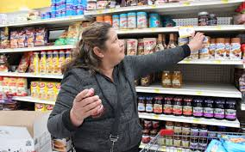
How does Illegal immigration help?
Immigrant investments and composition of things allow for many jobs to be created.
When an illegal immigrant goes to the store and buys products they are allowing for a cashier, manager, or even janitor to maintain a job.

Slide 16
More economic help:
Due to money being spent by illegal immigrants
The total goods and services that immigrant contribute to totals to $800,000

Slide 17
Who Do they Help? How Do they help them?
Immigrant spending helps
Business
Help maintain business existent
Example: Central Valley, with much of the population being illegal immigrants, small business would close without their prescience.
Example: Arizona
Employees
Creates jobs for employees because many businesses are continually visited by illegal immigrants who spend their money there.

Slide 18
Help they Professionals/ Skilled Workers:
Giovanni Peri, an Economist at UC Davis, conducted a study on how illegal immigrants help professional/ skilled workers.
The way in which he was a able to study this was by comparing states with illegal immigrants and states who had a much more smaller amount of illegal immigrants.
He discovered that illegal immigrant have actually help increase the wages of professionals!

Slide 19
How does it work?
In “ Wealth of Nations” by Adam Smith, he describes that a characteristic of a good economy is the distribution of jobs to the people who are skilled in a specific area.
That same concept applies to Peri’s findings.
Example
If an illegal immigrant takes over routine jobs, then, skilled workers like carpenters and electricians can concentrate entirely on what they do best.
Peris final conclusions were very impressive as he discovered that from 1990 to 2007, illegal immigrant helped increase the salary's of skilled workers by more than 10%. (Davidson, 2013)

Slide 20
What Do Economist think?:
96% of economist believe the US has been benefited more than it has been hurt.
Only 4% believe that illegal immigration has hurt the economy more than it has helped.

Slide 21
Conclusion
Even with the demand for illegal immigration to be stopped, there is no doubt that illegal immigrant not only contribute to the US economy, but also play a vital role in aspects of so many people.
They contribute their fair tax share, they can potentially provide extensive help to Baby Boomers, they are the laborers' that are key to maintain US Ag. Economically stable and improving, they are the compliments to professionals, they keep many places in business, they create employment, and like Americans keep billions of dollars circulating.
Numbers don’t lie, and they have demonstrated how illegals have become an important asset to the American economy.
Illegal immigration might not be politically correct, but economically, it is undeniable good for millions of people and organizations that are important to our economy.

Slide 22
Works Cited:
Agricultural Labor and Immigration Reform. (2015). Retrieved November 29, 2016, from Choicesmagazine.org: http://www.choicesmagazine.org/choices-
magazine/submitted-articles/agricultural-labor-and-immigration-reform
Davidson, A. (2013, February 12). Do Illegal Immigrant Actually Hurt the US Economy? Retrieved November 29, 2016, from www.nytimes.com: http://www.nytimes.com/2013/02/17/magazine/do-illegal-immigrants-actually-hurt-the-us-economy.html
POO, A.-J. (2015, March 9). PBS NEWSHOUR. Retrieved November 29, 2016, from www.pbs.org: http://www.pbs.org/newshour/making-sense/americas-boomers-and-undocumented-immigrants-need-each-other/
Procon.org. (2015, April 2). Is illegal Immigration a burden to the United States? Retrieved November 29, 2016, from Procon.org: http://immigration.procon.org/view.answers.php?questionID=000788

