Slide 1
Karen Moreno

Slide 2
Art Style
Art has been one of my favorite hobbies ever since I was a little girl. Through my childhood I spend most of my doing art . I always drew, painted, sculpted, did crafts, etc.. As I grew up the only Art form that remained with me was Drawing. I would draw in my free time and my style developed into more of realistic style.

Slide 3
Table of Contents
Non-objective Drawing
Mona Lisa
Tribal Drawing
Lindsay L
Charcoal Drawing
The Mad Hatter

Slide 4
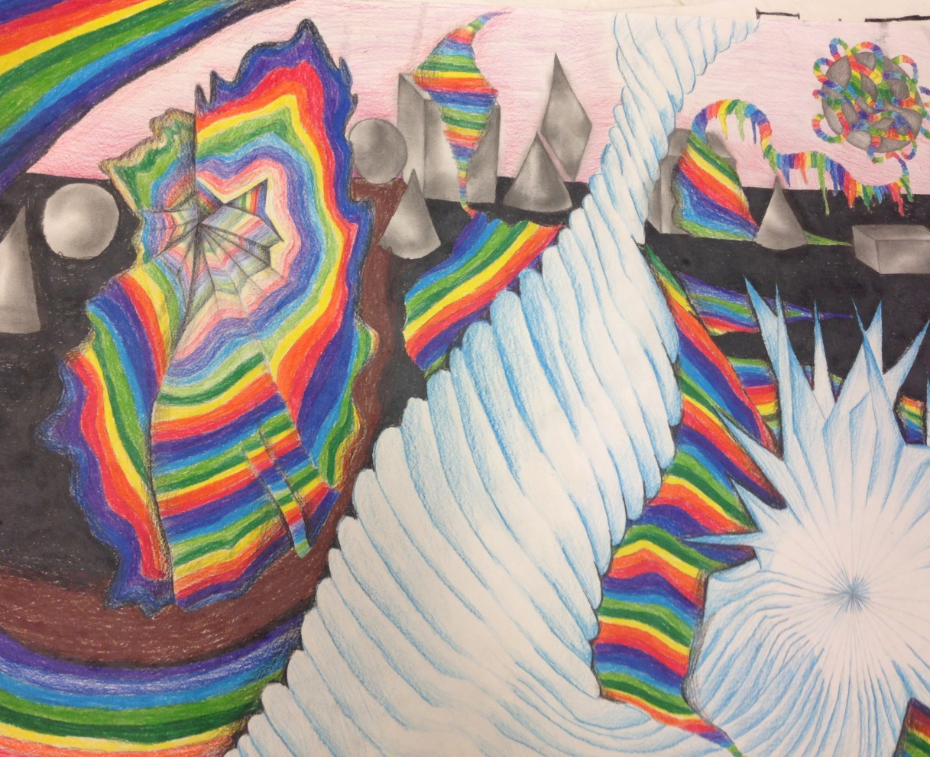
Non-Objective Drawing
Colored pencils
(22x18)
2015

Slide 5
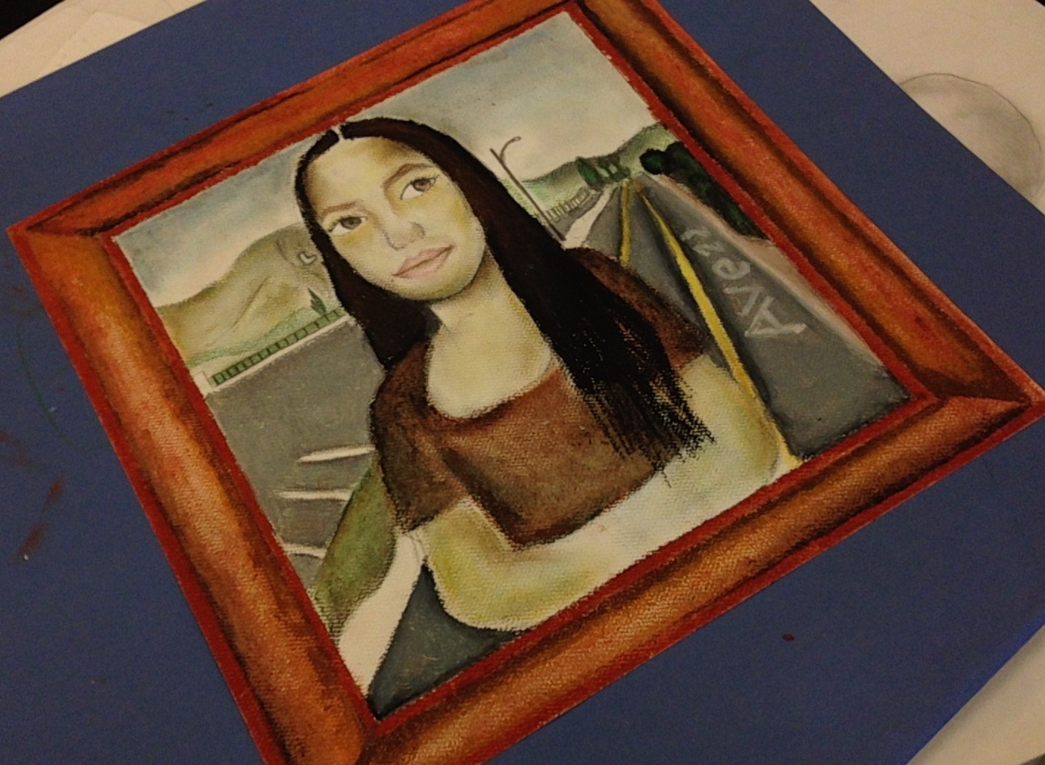
Mona Lisa
Oil Pastels
(7x7)
2015

Slide 6
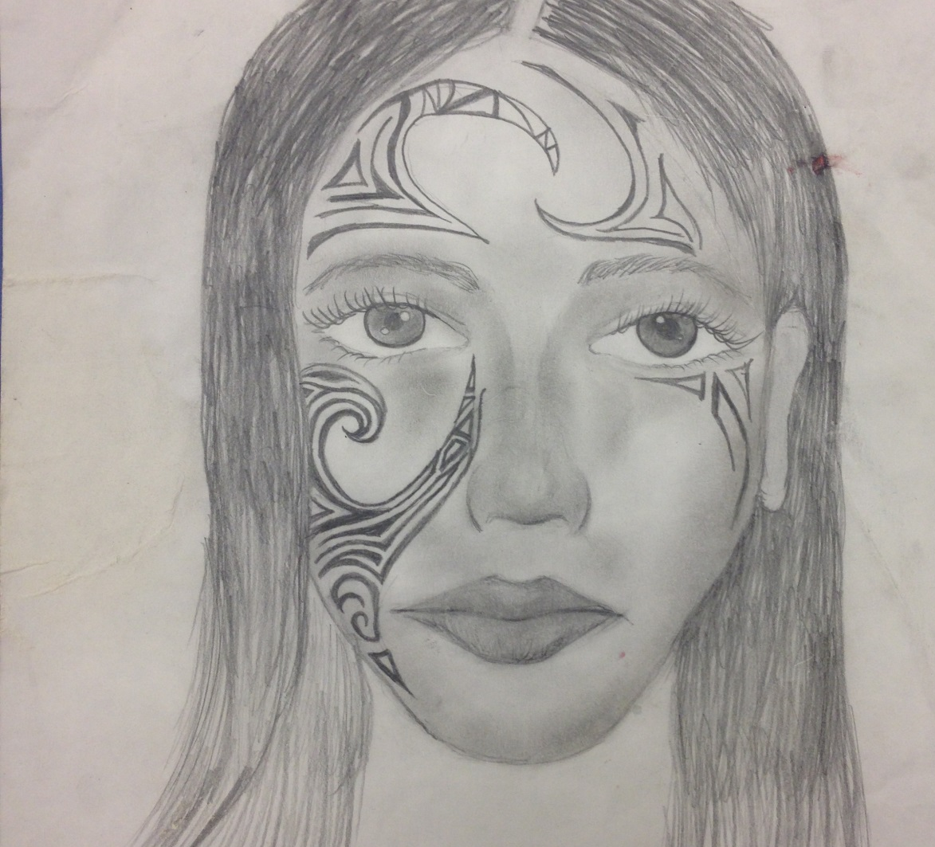
Tribal Face Drawing
Pencil
(11x7)
2016

Slide 7
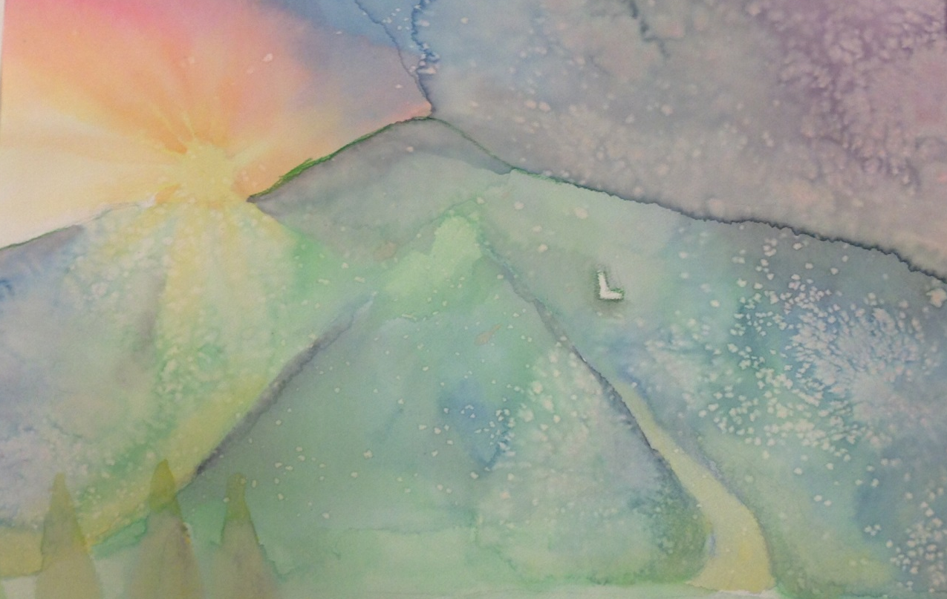
Lindsay L
Oil Colors
(22x18)
2016

Slide 8
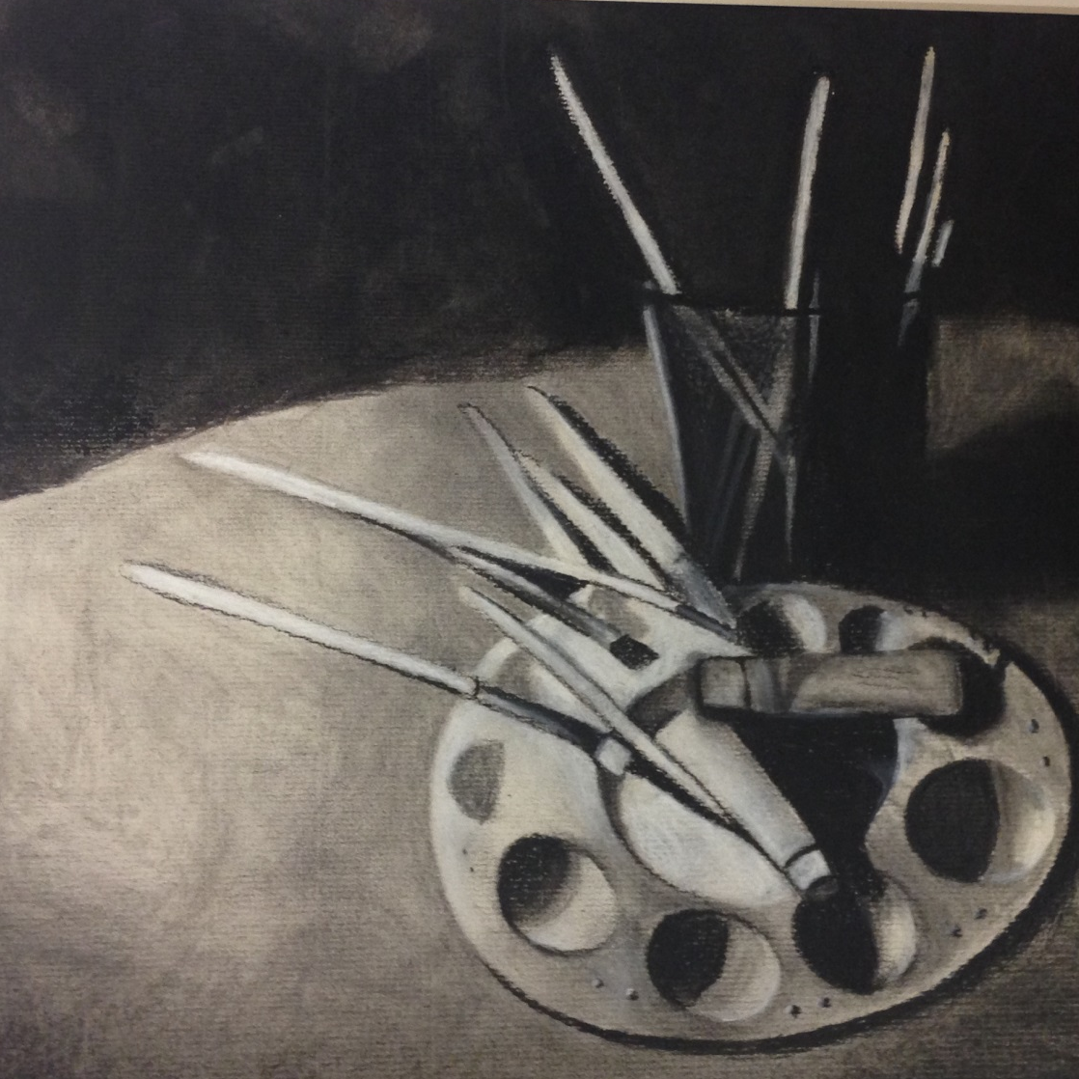
Charcoal Drawing
Charcoal
(7x7)
2016

Slide 9
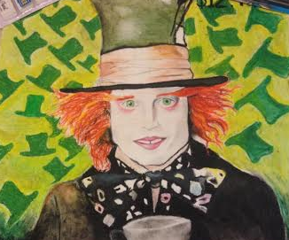
The Mad Hatter
Oil Pastels and Colored Pencils
(22x18)
2016

