Slide 1
Psychoanalytic Theory: Freud's Psychosexual Stages
By Karen Moreno

Slide 2
History of Psychoanalysis:
Established in America between WW1 and WW2
The most popular part of the Theory became ego psychology and influenced many to travel to the United States
Popular text included
The ego and the Id
The Problem of Anxiety
Became popular in American for about 50 years

Slide 3
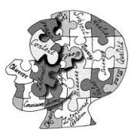
What is the Psychoanalytic Theory?
A theory that explains adult behavior through childhood experiences or the unconscious mind.

Slide 4
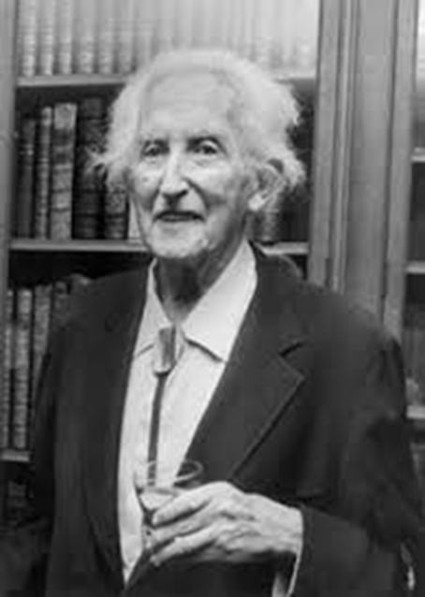
Influential People: Erik Erikson
Added on to the Theory
Believed that culture and society influenced the ego of a person
Focused on how social interactions influence personality
Came up with the idea of 8 stages beginning at birth in which a person develops trust and identifies who they are in society.

Slide 5
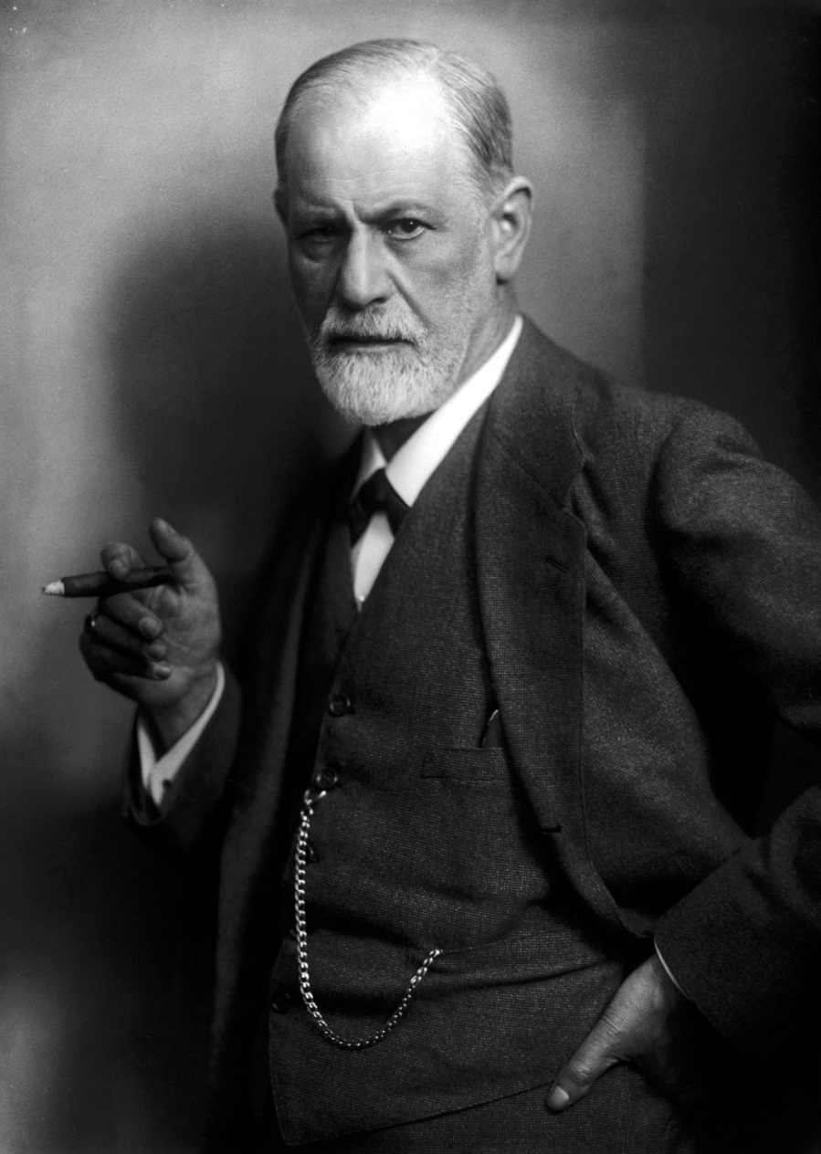
Sigmund Freud
19th Century Scientist
Developed a Controversial
Theory, Psychoanalysis
Had multiple ideas on personality development, mental health, and various illness theories.
Emphasized the idea that behavior was caused by our unconsciousness
He came up with a psychosexual development to explain how different adult traits result from childhood experiences.

Slide 6
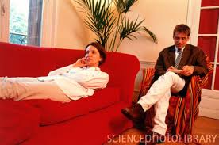
How is it an approach?
It attempted to cure behavior through multiple sessions
A patient sits down and expresses their thoughts, meanwhile the therapist takes note
This provided information about the unconscious mind
Free Association- A patient would blurt out words after hearing a word said by the therapist.

Slide 7
What is psychosexual Development?
Personality develops over the course of childhood up until age of 5
Personality develops through a series of childhood stages focused on certain erogenous area( mouth, anus, etc.)
Sexuality: all pleasurable actions and thoughts
Libido (psychosexual energy)-driving force behind behavior
If stages are completed successfully, a healthy personality is the result.
The problems face on each stage are reflected in adult personality
As areas of the body develop into sources of potential frustration or/and pleasure
What develops is how sexual energy accumulates and is discharged as we mature

Slide 8
The Role of Conflict
Each stage is associated with a conflict needed to be solved so the individual can advance to the next stage
Release sexual energy as needed in your stage and obtain the positive characteristics of that stage.
Troops Analogy: As troops advance, they face opposition or conflict. If they are highly successful in winning the battle or resolving the conflict, they will be able to go on to the next battle or the next stage. ( The greater the conflict the easier the troops can stay in that same battle without being able to move on.

Slide 9
Frustration, Overindulgence, Fixation
Some people don’t leave one stage to go to the other
Needs in one stage may have not been adequately met, which causes frustration
Or needs may have been over satisfied that the person is reluctant to leave that stage (overindulgence)
Both frustration and indulgence can lead to a fixation
Fixation: refers to an individual being invested in one stage of development
Some energy is invested in each stage, so, a person will behave in some ways that reflect infancy or early childhood.

Slide 10
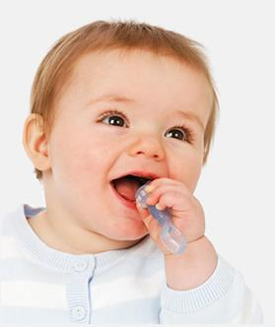
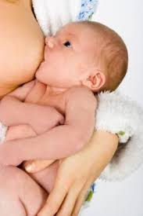
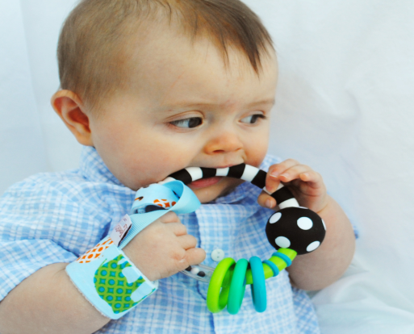
The Oral Stage:
Age Range: Infancy
Primary Focus: The Mouth
Things are put in mouth to satisfy
the Libido.
Infants primary source of interaction
is the mouth (sucking and rooting)
Mouth is vital for eating
Development: Because of caretakers like mom and dad the infant develops
trust and comfort

Slide 11
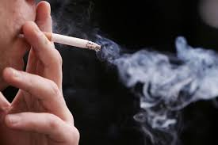
Traits and Fixations:
Potential Problems due to:
Children are weaned to early or too late
They experience oral deprivation or indulgence
Oral personalities engage in oral behaviors when they are under stress
Deprived Oral Pessimist will use the moth as punishment
May be very sarcastic
Become lawyer or dentist
Food faddists or drink prohibitionists
Speech pursuits, nail biters, pen chewers
Indulgent Oral Optimist
Sugar, wine, or food expert
Humorist
More likely to smoke
Like warm, milky, or mild foods

Slide 12
The Anal Stage
Age Range: 1-3 years
Bowel and bladder control
Major conflict: Toilet Training
Through toilet training child
comes into contact with the rules of society.
Controlling bodily needs
Person is aware of their capabilities, like controlling whether he pleases or frustrates his parent by expelling or withholding feces.
Developing results: Accomplishment and dependence

Slide 13
Traits and Fixations:
Praise and Rewards
encourage positive outcomes(child feels capable and productive)
Punish/ridicule/shame causes
messy, wasteful, destructive personality(anal expulsive personality)
Attitude to time, cleanliness, and money are linked to phase
Anal Eliminative are generous, untidy, & chaotic
Anal retentives are mean, meticulous, and mindful
They become officialdom, quality controllers, and bakers

Slide 14
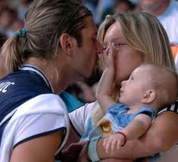
The Phallic Stage
Age Range: 2-5
Primary focus: genitals
Children discover difference between men and women
Boy view father as rival for mother affection(The Oedipal Complex)
Castration anxiety: fear of punishment from dad
Child identifies with the same sex parent as means of possessing other parent

Slide 15
Traits and Fixations:
Characteristics Associated with stage
Pride and doubt
boldness
timidity
Vanity or recklessness in adulthood
Poor resolution: leaf to promiscuity or chastity.
Parent fixation
Always focusing on the past

Slide 16
The Latent Period:
Libido (sexual) interests are suppressed
Development of ego and superego contribute to this period of calm.
Begins when children enter school and become concerned with relationships, hobbies, and other interests.
Time of exploration where sexual energy is directed to intellectual pursuits and interactions.
Stage is important in development of communication skills and self-confidence

Slide 17
Fixations:
Asexual
Workaholic
Focus on the same sex

Slide 18
The Genital Stage:
Age Range: Puberty to death
Strong sexual interest in the opposite sex
Begins in puberty but remains throughout whole life
Different from rest of stage which is focused only on individuals needs, interest and the interest in the welfare of others grows during this stage.
If other stages completed successfully, the individual should be well-balanced, warm, and caring.
Goal: to establish a balance between the various areas of life.

Slide 19
Fixations:
Guilt of sexuality
Feelings of inadequacy
Poor sexual relationships
Anxious feelings regarding the opposite sex

Slide 20
Citations:
McLeod, S. A. (2008). Erik Erikson. Retrieved
http://www.simplypsychology.org/Erik-Erikson.html
About Psychoanalysis. (n.d.). Retrieved September 22, 2014, from
http://www.apsa.org/About_Psychoanalysis.aspx
Adrian Furdham, (2015). Psychosexual Stages: Freads Theroy.
https://www.psychologytoday.com/blog/sideways-view/201509/psychosexual-stages-freud-s-theory

